Slide 1

The Diversity + Inclusion Timeline

Slide 2
For the last two decades, a growing body of research tells us that diverse and inclusive workplaces are linked to greater innovation, talent retention, and profit.

Slide 3
Diversity and inclusion is now widely accepted as a business imperative.
But diversity and inclusion is also a movement, with roots in social justice, and legal history.

Slide 4
We put together a timeline of the history of the Diversity and Inclusion Movement, beginning in 1961 with Affirmative Action.
On the last slide, you’ll find a downloadable 11 x 17 poster.

Slide 5

1961
President John F. Kennedy signs an executive order establishing “affirmative action” requirements for government contractors.
“The contractor will take affirmative action to ensure that applicants are employed, and that employees are treated during employment, without regard to their race, creed, color, or national origin."

Slide 6
1964
The Civil Rights Act makes it illegal for employers to discriminate on the basis of race, sex, religion, or national origin and establishes the U.S. Equal Employment Opportunity Commission (EEOC).

Slide 7
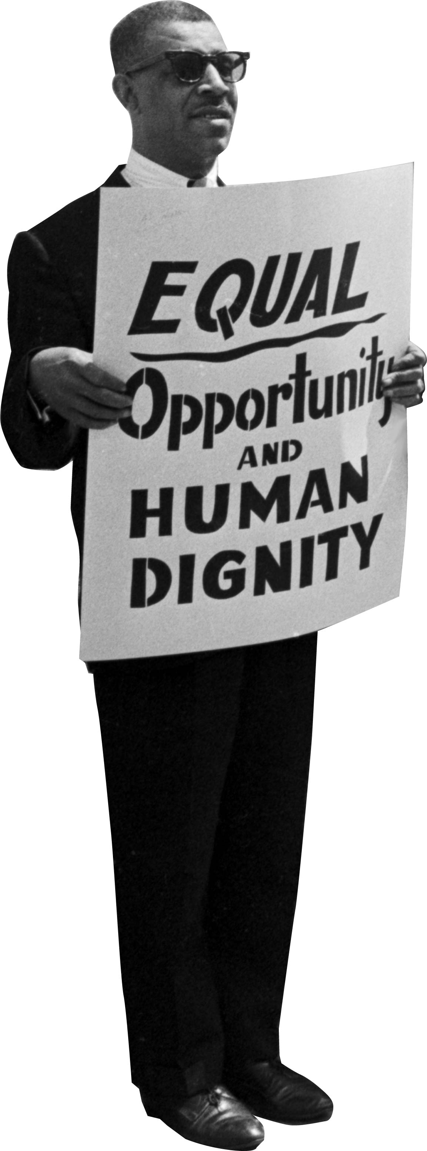
1972
The Supreme Court gives EEOC the authority to sue for discrimination. Companies provide affirmative action training
^{to prevent litigation.}
Photo: Alabama Department of Archives and History

Slide 8

1974
Black employees at Xerox have formed seven independent caucus groups since the late 1960s. These are the first ERGs.

Slide 9
1987
Workforce 2000, a landmark study by the Hudson Institute predicts a changing workforce that will be older, more female, multicultural, and racially diverse. The report establishes “workforce diversity” as a positive business practice.

Slide 10

Americans with Disabilities Act is
^{signed into law.}
1990

Slide 11
1991
63% of major firms offer diversity training, according to a 1992 study published by the Conference Board.

Slide 12

1993
The Family and Medical Leave Act gives parents the right to 12 weeks of unpaid leave to care for a new child.

Slide 13
2000
The Chief Diversity
Officer rises.

Slide 14

2009
Ursula Burns, an executive who began her career in engineering, is named the first black female CEO of a Fortune 500 Company.

Slide 15
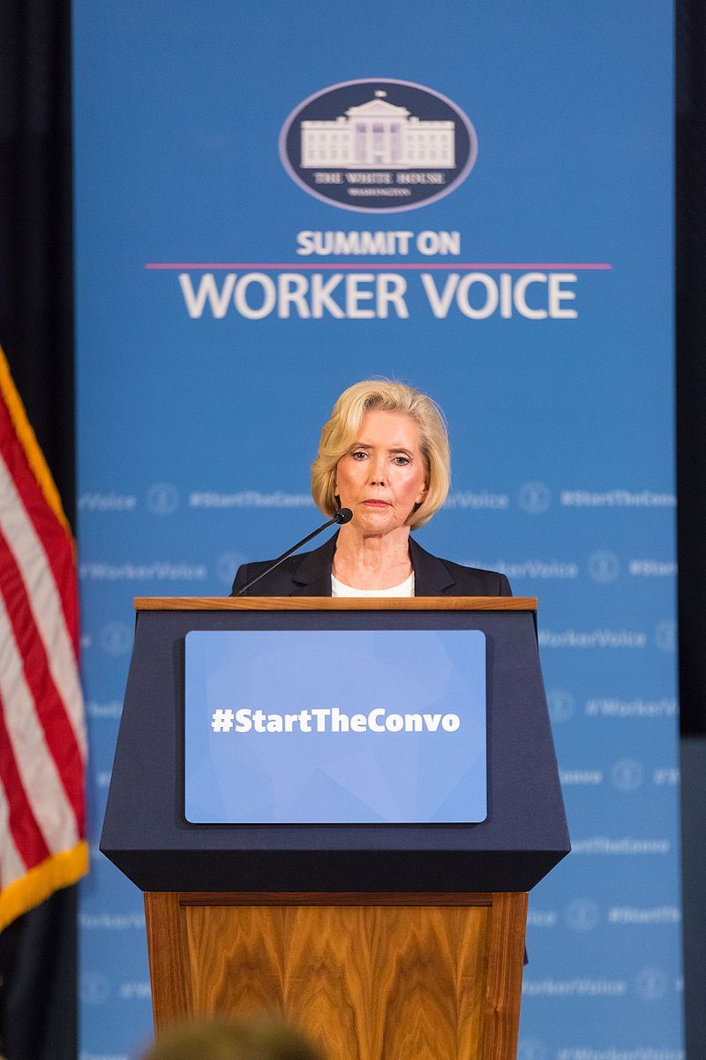
2009
The Lilly Ledbetter Fair Pay Act strengthens
protections against pay discrimination.

Slide 16

2013
Markets are becoming more diverse. A growing body of research reveals the business imperative for D&I and the high cost
of bias.
Source: Center for Talent Innovation

Slide 17

2013
Footage of police shootings of unarmed black people gives rise to Black Lives Matter. Leaders from several high-profile companies express support.

Slide 18
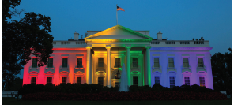
2016
CEO activism rises. More than 90 executives speak out against North Carolina’s anti-LGBT law.

Slide 19

2017
Journalists expose sexual abuse and assault in the highest places, setting off a global movement. Within a year, more than 200 executives lose their jobs due to accusations of sexual misconduct.

Slide 20
2018
^{Board diversity grows.}
145 Fortune 500 companies have at least 40 percent diversity on their boards, up from 69
^{in 2012.}

Slide 21
Fortune 500 CEOs include 33 women (the most in history) but just three African- American men, and zero Latinas. We ^{have much more work to do.}
2019

Slide 22

The Diversity + Inclusion Movement

Slide 23

To download a copy of this 11 x 17 poster,
visit www.talentinnovation.org/timeline

